Slide 1
SAC Presentation
Developing a Career in Early Childhood Education
Chantal Lamourelle, M.S.

Slide 2
Your focus: Degree
Child Development / Early Childhood Education
Liberal Arts
Adolescent and Youth Development
Intervention and Special Needs
What will you do with your degree?

Slide 3
Your focus
Career
or
Job
Which do you want?

Slide 4
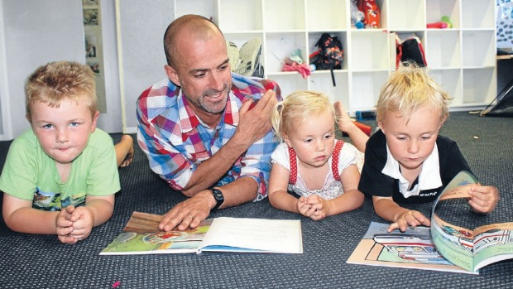
First: Focus on YOU
Temperament
Multiple Intelligence
Strengths Quest
Favorite Songs-happy, motivation,
party, encouraging
Professional Esteem
Balanced life between career
and play
Who are you?
Notes:
Knowing who you are, how you learn best will support your journey in education and life!

Slide 5
I know who I am, know what?
Use the information you learned about
yourself and apply it to every aspect
of your life
How can you determine
what you want in your career and life?
Make Mis-takes
Make a dream board
Create your dream life!
Notes:
1) Use the information to help you with establishing routines, good habits, dealing with stress, etc. 2) Practicing, doing new things (Uncomfortable), become a renaissancee ( I made this term up:) of teaching careers to detrmine what you enjoy, do not limit your experiences by experiences ( ex. Me and Pretend City) 3) Embrace mis-takes, that is how we learn, grow and change. “No” just means, “NOt now”

Slide 6
Developing Your Resume
Education
Practical Experience
Research Experience
Affiliations
Awards & Scholarships
You have to be an active learner too!

Slide 7
Education
During your community college experience, what is possible?
Earn an Associates Degree in:
Early Childhood Education Degree for Transfer
Early Childhood Education Degree with Emphasis on Infant/Toddler Care
Early Childhood Education Degree with Emphasis on Preschool Age Care
Early Childhood Education Degree with Emphasis on School-Age Care
Certificates
Child Development Permit for Early Care and Education through the California Commission on Teacher Credentialing ( CA Permit) https://www.ctc.ca.gov/credentials/req-child-dev and https://www.childdevelopment.org/cs/cdtc/print/htdocs/services_permit.htm
Search for an Educator: https://educator.ctc.ca.gov/esales_enu/start.swe?SWECmd=GotoView&SWEBHWND=&SWEView=CTC+Search+View+Web&SRN=&SWEHo=educator.ctc.ca.gov&SWETS=1573861291
Infant/Toddler -School-Age Care Santa Ana College Certificate Programs
SAC Curriculum Certificates: Special Needs Certificate, Spanish Bilingual Certificate, STEAM Certificate
What is next?
B.A. in Child Development, Education
Teaching Credential / CA Permit
Graduate/other degree
Specialized training- service learning hours
On-going professional development

Slide 8
Have you taken the time to
Meet with your professors and counselors?
Explore your future options?
Visit your department’s website?
Take a tour of a local university?
Speak with experienced students?
Attend a presentation (YES!)?
Don’t wait until it’s too late…

Slide 9
Developing Your Resume
Education
Practical Experience
Research Experience
Affiliations
Awards & Scholarships
You have to be an active learner too!

Slide 10
Practical Experience
Types:
Service- Learning Hours/Fieldwork/Volunteer work
Paid, low-level employment
Internships (e.g., canfit.org)
Community Service
Things to Consider:
Money
Specific depth or breadth
Skills and/or resume

Slide 11
Field Experience
1. Preschool
(IT-4 years)
2. Transitional
Kindergarten
3. Elementary
4. College
School Readiness
Special Ed Coord.
Preschool for All
Transitional Kindergarten
CLASS Consultant
QRIS Programs
School Readiness Coordinators
Preschool Consultants
Program Coordinators
Grant Writer
Education Consultant
Teaching
Proposition
10
OC Department
Of Ed
United Way
Info Link
Parent Coord.
Instructors
Nutritionist
Coordinator
Child Life Specialist
Resource &
Referral
Family
Resources
1. Regional Center of OC
2. Help Me Grow
3. 211
4. Family Support Network
5. Pretend City
Health
Agencies
Other
Agencies
CHOC
Health for Kids
Family Coord.
Private
Businesses
Too Many
To List
Education Business Owners
Consultant

Slide 12
Developing Your Resume
Education
Practical Experience
Research Experience
Affiliations
Awards & Scholarships
You have to be an active learner too!

Slide 13
Developing Your Resume
Education
Practical Experience
Research Experience
Affiliations
Awards & Scholarships
You have to be an active learner too!

Slide 14
Affiliations
On-Campus
Faculty references
Student leadership
Off-campus
Networking
Professional development
Job opportunities

Slide 15
Professional Organizations
State and National Level Organizations
California Association for the Education of Young Children (www.caeyc.org)
California Teacher’s Association (www.cta.org)
National Youth Development Information Center (www.nydic.org)
Local Level Organizations
Orange County Association for the Education of Young Children (www.ocaeyc.com)
School Districts
Student Organizations

Slide 16
Extracurricular Guidelines
Check for match (Goodness of fit)
Values
Goals
Needs
Do not over commit yourself
Network, network, network!

Slide 17
Networking
Work with a variety of professionals
Don’t make a good impression; MAKE A SUPER FANTASTIC IMPRESSION
Give back
Stay connected
Get written references

Slide 18
Developing Your Resume
Education
Practical Experience
Research Experience
Affiliations
Awards & Scholarships
You have to be an active learner too!

Slide 19
Awards & Grants
Types:
SAC Awards and Scholarships!
CSUF Awards Scholarships and Awards (100’s)
Association Scholarships
Professional Organizations
Why should I try?
Money, money, money
Can’t hurt (except time)
Puts your name out there
Funds trips / school
Not enough people apply
Practice makes permanent
Great for your resume!

Slide 20
General Do’s and Don’ts
Do the following:
Say, “Yes!”
Save copy of everything
Do your homework
Speak, think, dress and BE success
Communicate
Be grateful
Do not do the following:
Show up unprepared
Leave without communicating
“Try” just Do or Don’t
Burn bridges

Slide 21
Get out and share your gifts!
QUESTIONS?
CHANTAL LAMOURELLE
714.564.6875 or 949.307.2398
LAMOURELLE_CHANTAL @SAC.EDU
MENTORLAMOURELLE@GMAIL.COM
Thank you!
Make today matter!

